Slide 1
Ubuntu 19.10 (Eoan Ermine)
Introduction
Bin Li bin.li@canonical.com

Slide 2
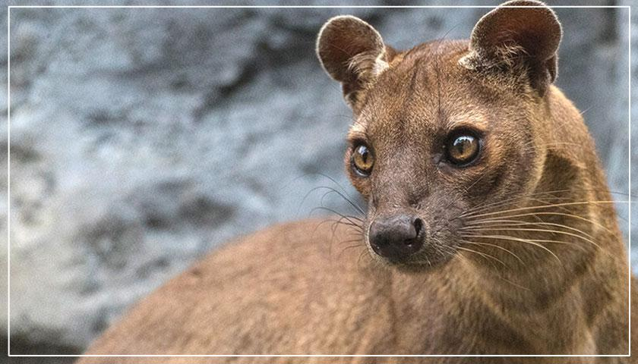
Ubuntu 20.04 LTS
(Focal Fossa)

Slide 3
Linux Kernel 🐧
Based on 5.3
New hardware support
  AMD Navi GPUs,new ARM SoCs, ARM Komeda display
  Intel Speed Select on Xeon servers
Developer-facing features
  pidfd support for avoiding races cause by pid reuse
  A new mount api
  The io_uring interface for asynchronous I/O
LZ4 kernel compression algorithm

Slide 4
Toolchain Upgrades 🛠️
glibc 2.30
☕ OpenJDK 11
rustc 1.37
GCC 9.2
🐍 Python 3.7.5, Python 3.8.0 (interpreter only)
💎 ruby 2.5.5
php 7.3.8
🐪 perl 5.28.1
golang 1.12.10 https://golang.org/doc/go1.12

Slide 5
Ubuntu Desktop
GNOME 3.34 Desktop (“Thessaloniki”)
group icons
Improved system settings
Improved performance (Lower CPU usage)
https://help.gnome.org/misc/release-notes/3.34/
New themes: Yaru light and dark
DLNA sharing
The Chromium browser is only available as a snap in 19.10
Snap support theme

Slide 6
Ubuntu Desktop
ZFS on root
  experimental feature
  installer create the ZFS file system automatically
NVIDIA-specific improvements
  The driver is now included in the ISO
  Improved startup reliability and endering smoothness
Updated Applications
  LibreOffice 6.3
  Firefox 69
  Thunderbird 68
Updated Subsystems
  PulseAudio 13.0

Slide 7
Ubuntu Server
Images
  ppc64el and arm64 live-server ISO images
QEMU 4.0
  Migrations
  create a virtual 3D GPU
libvrt 5.6
  Parallel connections for migration
MySQL 8.0
  mysql-router package
PHP 7.3
Raspberry Pi 🍓 (Pi 2, Pi 3B, Pi 3B+, CM3, CM3+, Pi 4)
Openstack Train

Slide 8
Thanks! https://wiki.ubuntu.com/EoanErmine/ReleaseNotes
Bin Li
bin.li@canonical.com

